Slide 1
Measuring The Cost of Living
Notes:
1
1

Slide 2
Overview
Learn how the Consumer Price Index (CPI) is constructed.
Calculating Consumer Price Index and the Inflation Rate.
Problems in measuring the cost of living.
Correcting economic variables for the effects of inflation.
Notes:
2
2

Slide 3
Measuring the Cost of Living
In determining the cost of living, Statistics BD first identifies a “market basket” of goods and services the typical consumer buys.
Annually, Statistics BD surveys consumers to determine what they buy and the overall cost of the goods and services they buy.
Notes:
3
3

Slide 4
Measuring the Cost of Living
The Consumer Price Index (CPI) is used to monitor changes in the cost of living (i.e. the selected market basket) over time. When the CPI rises, the typical family has to spend more dollars to maintain the same standard of living.
The goal of the CPI is to measure changes in the cost of living. It reports the movement of prices not in dollar amounts, but with an index number.
Notes:
4
4

Slide 5
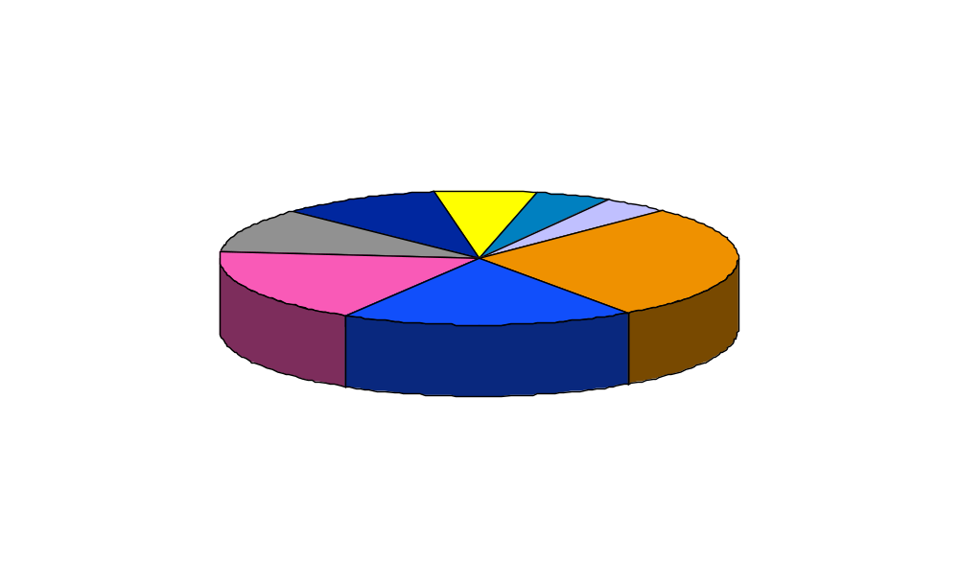
What’s in the CPI’s Basket?
Notes:
5
5

Slide 6

What is an Index Number?
An Index Number is developed with an arbitrary base (usually starting with 100) that indicates a change in magnitude relative to its value at a specified point in time.
Notes:
6
6

Slide 7
Overview
Learn how the Consumer Price Index (CPI) is constructed.
Calculating Consumer Price Index and the Inflation Rate.
Problems in measuring the cost of living.
Correcting economic variables for the effects of inflation.
Notes:
7
7

Slide 8
Calculating the Consumer Price Index and the Inflation Rate
Determine what goods are most important to the typical consumer: Fix the Basket
Find the prices of each of the goods and services in the basket for each point in time: Find the Prices
Use the data on prices to calculate the cost of the basket of goods and services at different times: Compute the Basket’s Cost
Designate one year as the Base Year, which is the benchmark for yearly comparison.
Notes:
8
8

Slide 9
Calculating the Consumer Price Index and the Inflation Rate
The final step includes using the CPI to calculate the Inflation Rate, which is:
  the percentage change in the price index from the preceding period
Example:
  Base Year is 2000
  Bundle of goods in 2000 = $1,200
  The same bundle in 2002 cost = $1,272
  CPI = ($1,272 ÷ $1,200) X 100 = 106
  Prices between 2000 & 2001 increased 6%
Notes:
9
9

Slide 10
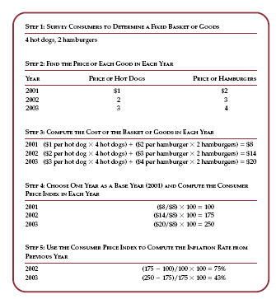

Slide 11
Other Price Indexes
Other Price Indexes are computed for:
  Specific regions within the country (e.g. each District and for 6 cities across Bangladesh)
  Narrow categories of goods and services (e.g. food, clothing, etc.)
  Producer costs of resources (i.e. industrial product price index)
Notes:
10
10

Slide 12
Overview
Learn how the Consumer Price Index (CPI) is constructed.
Calculating Consumer Price Index and the Inflation Rate.
Problems in measuring the cost of living.
Correcting economic variables for the effects of inflation.
Notes:
11
11

Slide 13
Problems in Measuring The Cost of Living
The CPI is an accurate measure of the selected goods that make up the “typical bundle,” but it is not a perfect measure of the “cost of living.”
Three reasons/problems:
  Substitution Bias
  Introduction of new goods
  Unmeasured quality change
Notes:
12
12

Slide 14
Problems of CPI: Substitution Bias
The bundle does not change in the short run to reflect consumer reaction to changing relative prices.
  Consumers substitute toward goods that have become relatively less expensive.
  CPI is computed assuming a fixed basket of goods.
  The index overstates the increase in cost of living by not considering the substitution by the consumer.
Notes:
13
13

Slide 15
Problems of CPI: New Goods
The bundle does not reflect the effects of new products that typically go down in price after introduction.
  New products result in greater variety, which in turn makes each dollar more valuable. Consumers need fewer dollars to maintain any given standard of living.
  The CPI is based on a fixed basket of goods and does not reflect the change in the purchasing power of the dollar.
Notes:
14
14

Slide 16
Problems of CPI: Quality Changes
Higher market prices usually include quality changes that do not necessarily represent a higher cost of living.
  If the quality of a good decreases from one year to the next, the value of a dollar falls, even if the price of the good stays the same.
  The true cost of living may be less even though some goods cost more.
Notes:
15
15

Slide 17
Problems of CPI
The substitution bias, introduction of new goods, and unmeasured quality change tends to lead the CPI to overstate the increase in the cost of living by about half a percent (.5%)
This measurement error tends to overstate the “true” cost of living.
Notes:
16
16

Slide 18
The Consumer Price Index versus the GDP Deflator
The CPI:
  includes only consumption goods
  includes the cost of imports
  is a fixed bundle of goods
The GDP Price Deflator:
  includes all final goods and services
  excludes imports
  uses a current bundle of goods
Notes:
17
17

Slide 19

Quick Quiz!
Explain briefly what the consumer price index is trying to measure and how it is constructed.
Notes:
18
18

Slide 20
Overview
Learn how the Consumer Price Index (CPI) is constructed.
Calculating Consumer Price Index and the Inflation Rate.
Problems in measuring the cost of living.
Correcting economic variables for the effects of inflation.
Notes:
19
19

Slide 21
Correcting Economic Variables for the Effects of Inflation
Price indexes are used to correct for the effects of inflation when comparing dollar figures from different times.
When some dollar amount is automatically corrected for inflation by law or contract the amount is said to be indexed for inflation.
  e.g., COLA’s and Canada Pension Plan
Notes:
20
20

Slide 22
Correcting Economic Variables for the Effects of Inflation
To convert (inflate) past wages and prices into current terms:
  Current Year Dollars =
Past Year Nominal Value X [(Price index in current year) ÷ (Price index in past year)]
Notes:
21
21

Slide 23
Correcting Economic Variables for the Effects of Inflation
To convert (deflate) current wages and prices into past year terms:
  Value in Past Year Dollars =
Current Year Value X [(Price index in past year) ÷ (Price index in current year)]
Notes:
22
22

Slide 24
Real and Nominal Interest Rates
Interest represents a payment in the future for a transfer of money in the past.
Nominal interest rate:
  The rate that the bank pays in current value.
Real interest rate:
  The interest rate corrected for inflation.
  Real interest rate = Nominal - Inflation
Notes:
23
23

Slide 25
Real and Nominal Interest Rates
Example — Assume:
  You borrow $1,000 for one year.
  Nominal Interest rate was 15%.
  During the year inflation was 10%.
The real interest rate is:
    15% - 10% = 5%
Notes:
24
24

Slide 26
Conclusion
When comparing dollar values from different times, it is necessary to keep in mind that a dollar today is not the same as a dollar in the past.
The CPI illustrates one way that prices are measured and how to make adjustments for these price changes.
Notes:
25
25

Slide 27
Overview
Learn how the Consumer Price Index (CPI) is constructed.
Calculating Consumer Price Index and the Inflation Rate.
Problems in measuring the cost of living.
Correcting economic variables for the effects of inflation.
Notes:
26
26

